Slide 1

InstructPix2Pix: Learning to
Follow Image Editing Instructions
Tim Brooks, Aleksander Holynski, Alexei A. Efros

Slide 2
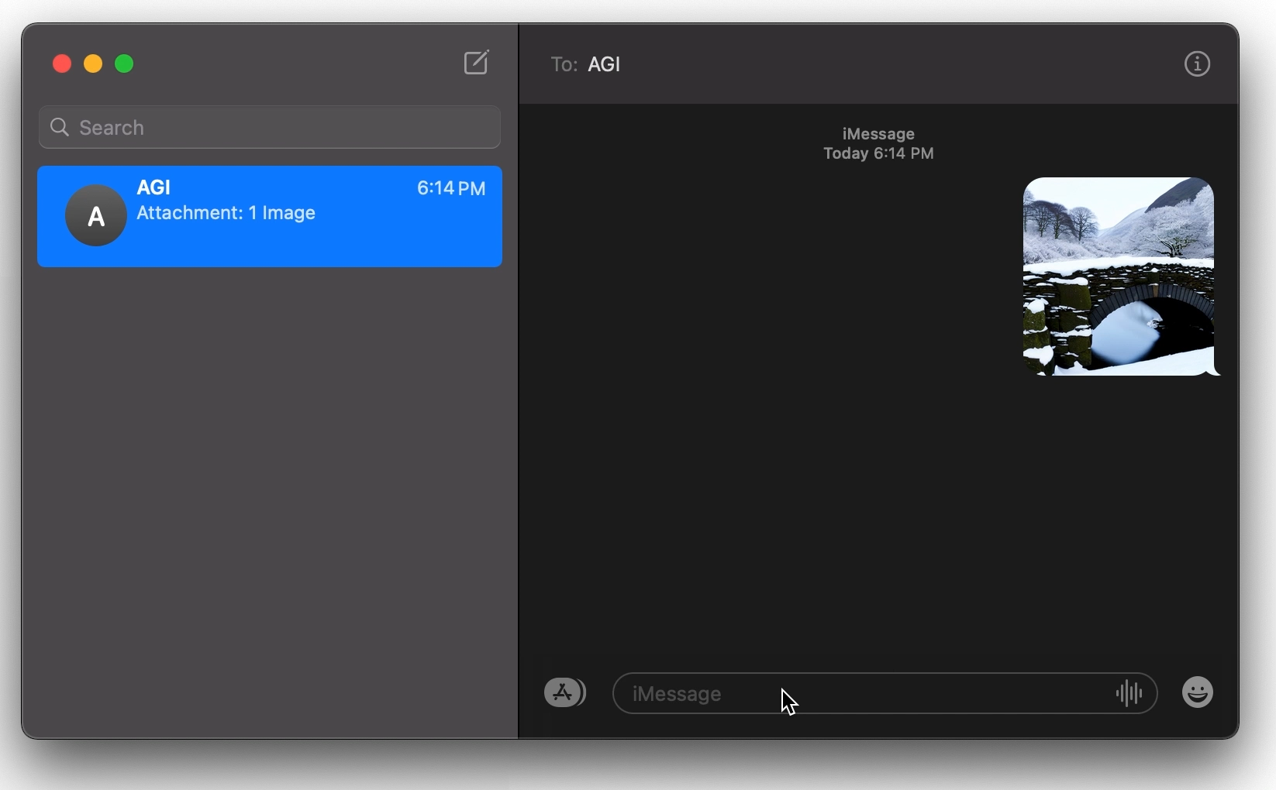
We want an AI image editor that does what we ask

Slide 3
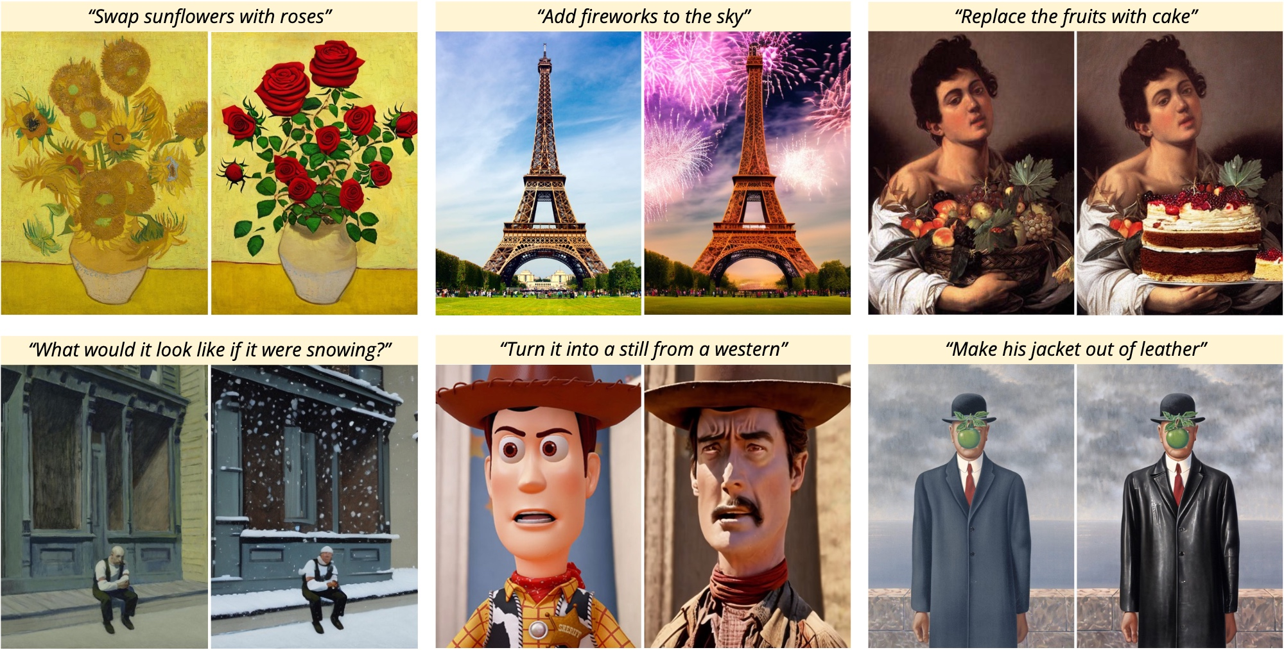

Slide 4
Editing images goals
Tell the model exactly what edit to make as a written instruction.
Require no extra input (full captions, additional images, drawn masks).
Perform edit in forward pass without need for inversion/finetuning.

Slide 5
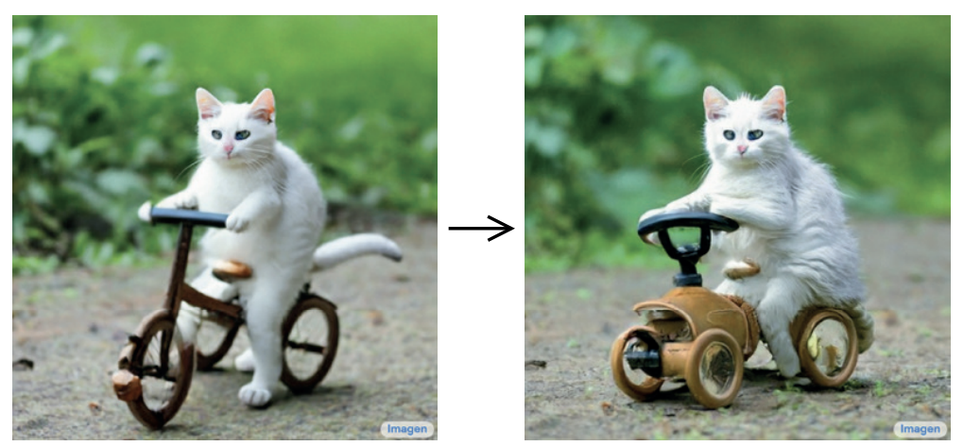
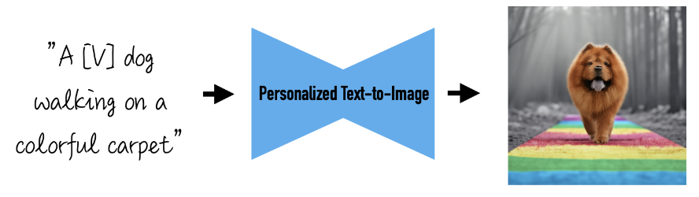
Related work: Prompt-to-Prompt
Only works reliably when both images are generated.
Requires full written description of both input and output images.
“Photo of a cat riding on a bicycle.”
“Photo of a cat riding on a car.”

Slide 6
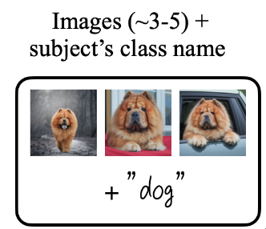

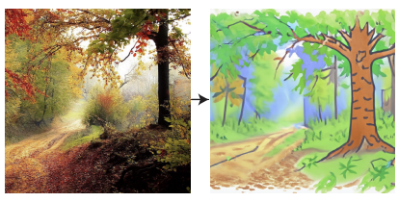
Related work: DreamBooth, Imagic
Expensive finetuning for every new input image.
Require full descriptions of the desired output image.
DreamBooth:
Imagic:
Optimize latents
“A children’s drawing of a forest”
Finetune model

Slide 7
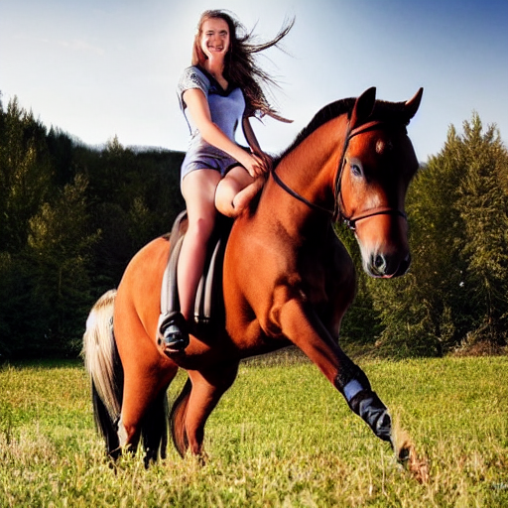
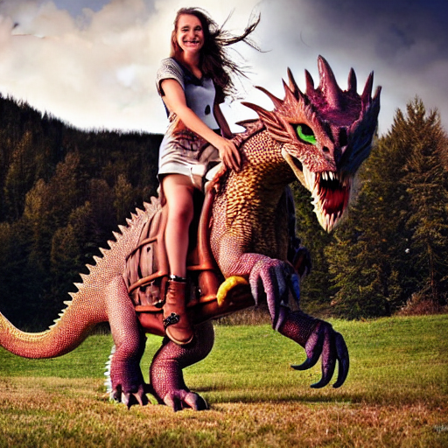
Our approach:
Train a large diffusion model to directly edit images.
Train on a large supervised dataset of paired images and instructions.
“have her ride a dragon”
InstructPix2Pix

Slide 8
Our approach:
Train a large diffusion model to directly edit images.
Train on a large supervised dataset of paired images and instructions.
…but where does this supervised dataset come from?
“have her ride a dragon”
InstructPix2Pix

Slide 9
Our approach:
Train a large diffusion model to directly edit images.
Train on a large supervised dataset of paired images and instructions.
…but where does this supervised dataset come from?
Combine knowledge of large pretrained models to generate training data.
“have her ride a dragon”
InstructPix2Pix

Slide 10
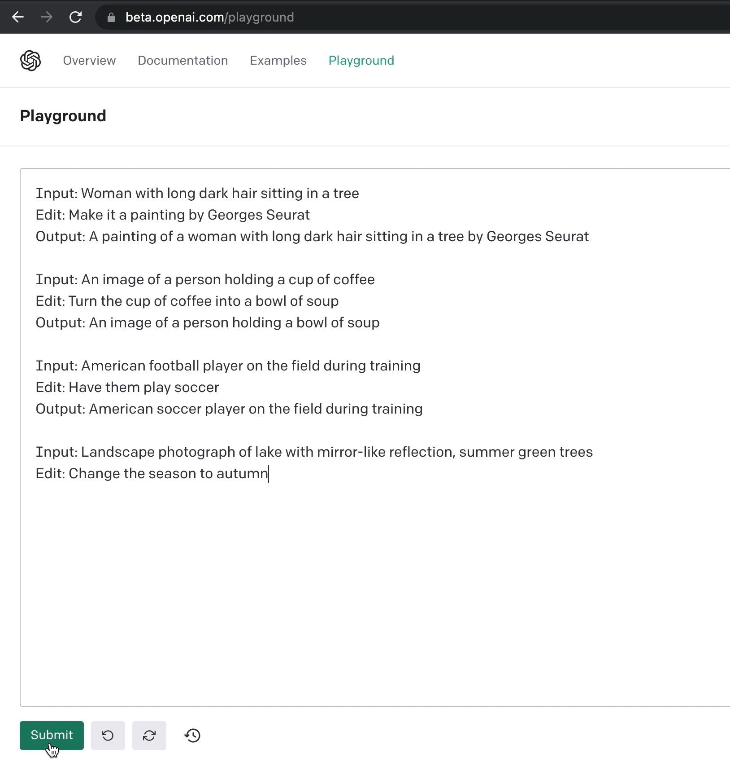

Slide 11
Generating caption edits with GPT-3
Finetune GPT-3 to generate instructions and before/after captions.
Train on 700 human-written image editing instructions.
Then generate >450,000 examples (providing LAION captions as input).

Slide 12
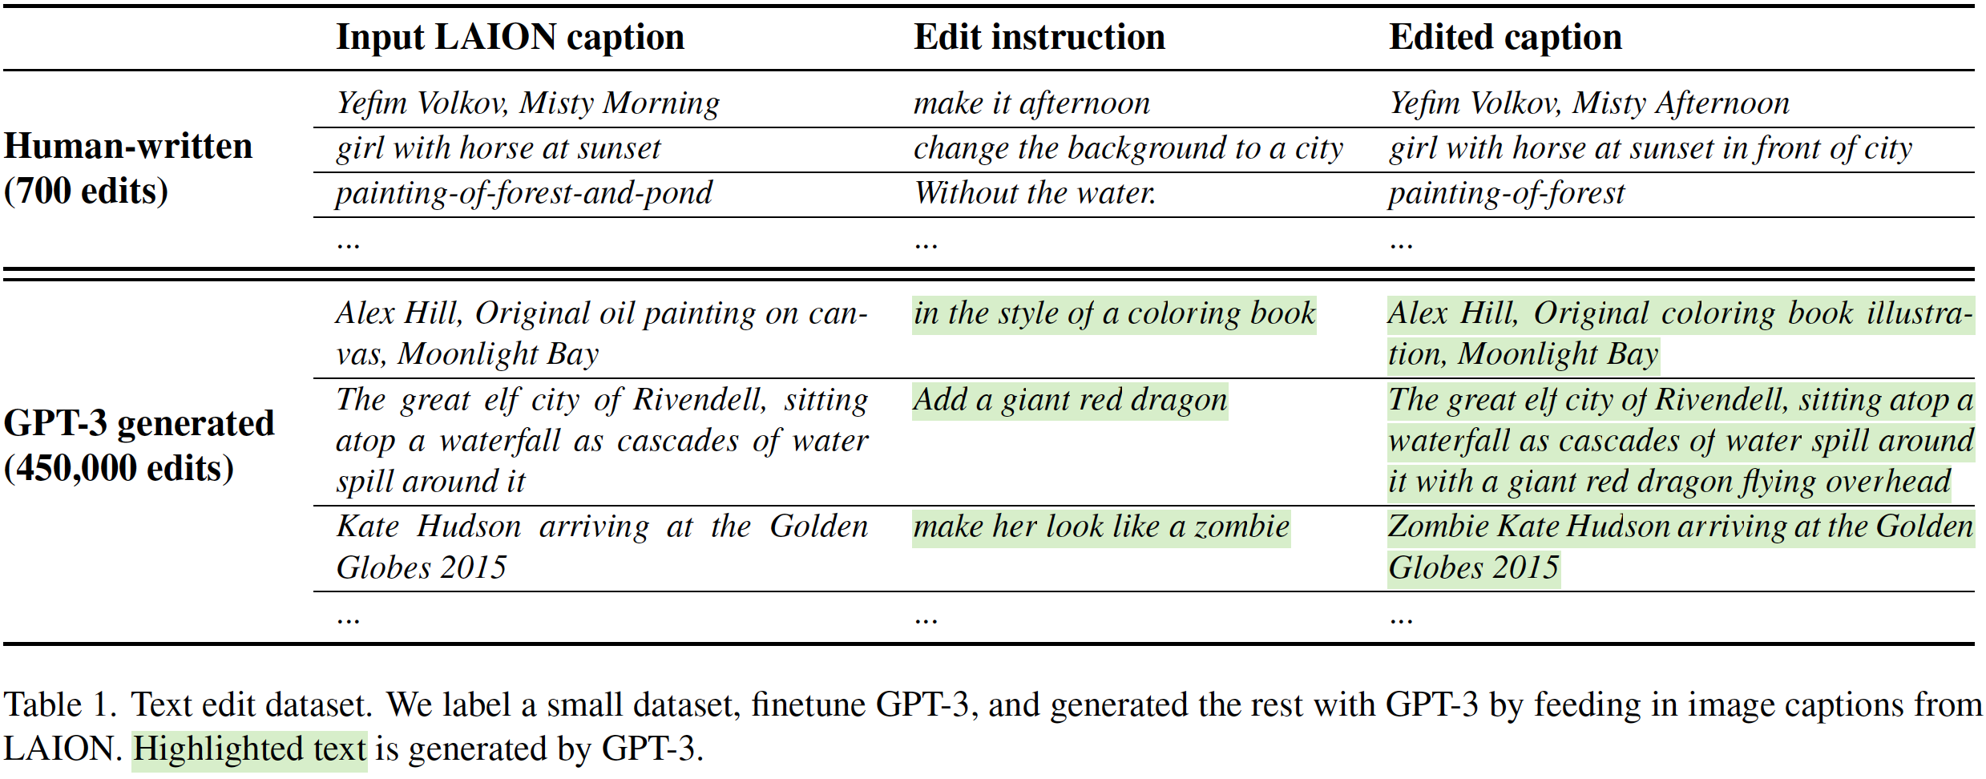
Generating caption edits with GPT-3

Slide 13
Generating pairs of images from captions
Use a pretrained text-to-image model to generate examples.
Leverage Prompt-to-Prompt method to make images look similar.
“Photo of a cat riding on a bicycle.”
“Photo of a cat riding on a car.”

Slide 14
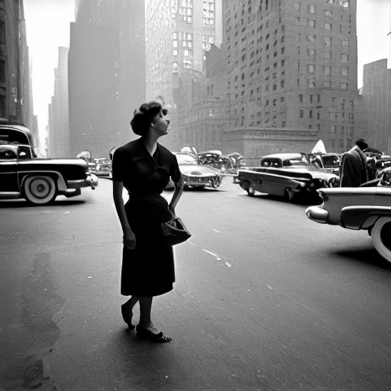
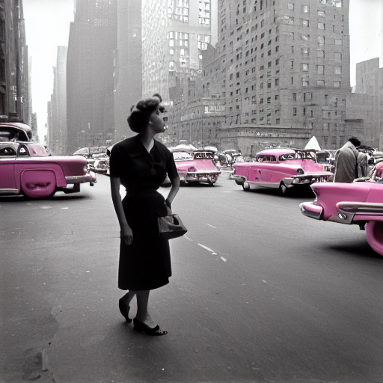
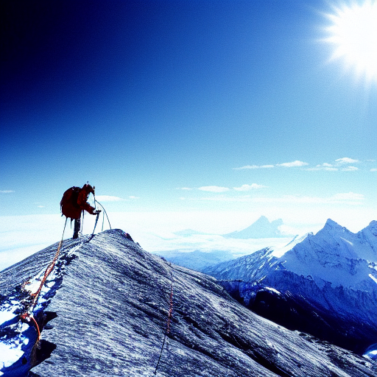
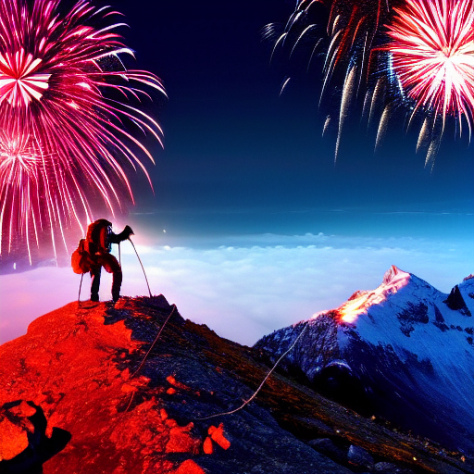
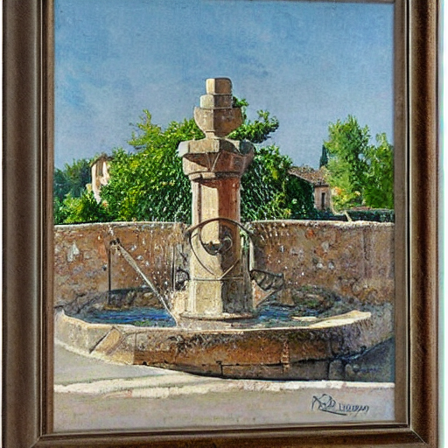
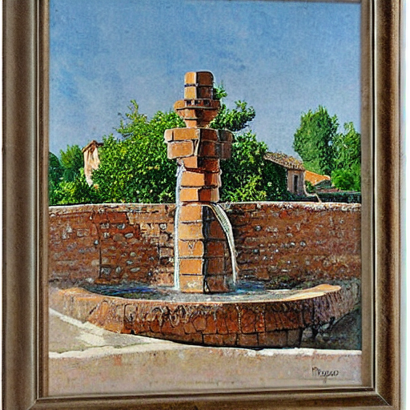
Generating paired training data
(1) Generate text edits:
GPT-3
(finetuned)
Instruction: “have her ride a dragon”
Edited Caption: “photograph of a girl riding a dragon”
Input Caption: “photograph of a girl riding a horse”
(2) Generate paired images:
Stable Diffusion
+ Prompt2Prompt
Input Caption: “photograph of a girl riding a horse”
Edited Caption: “photograph of a girl riding a dragon”
Generated training examples:
“have her ride a dragon”
“Color the cars pink”
“Make it lit by fireworks”
“convert to brick”
…

Slide 15

Training an image editing diffusion model
Now it is a supervised learning problem!
Finetune Stable Diffusion on generated training data.
Add zero-initialized image conditioning channels.
“have her ride a dragon”
InstructPix2Pix

Slide 16
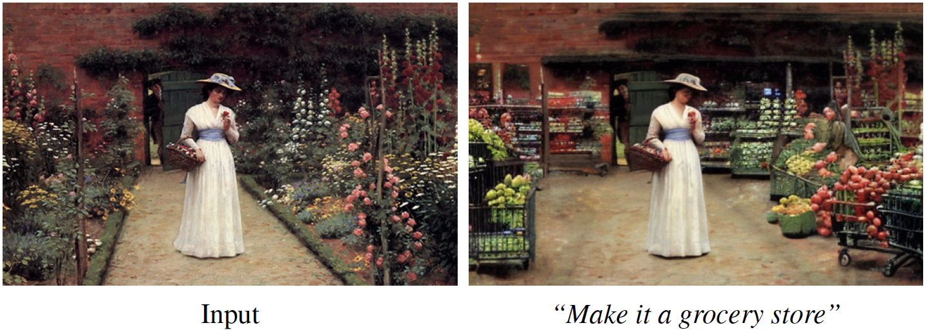
Generalization to real images and instructions
Trained only on generated images and instructions.
At inference, generalizes to real images and human-written instructions!
“Make it a grocery store”
InstructPix2Pix
Edmund Leighton’s Lady in a Garden

Slide 17
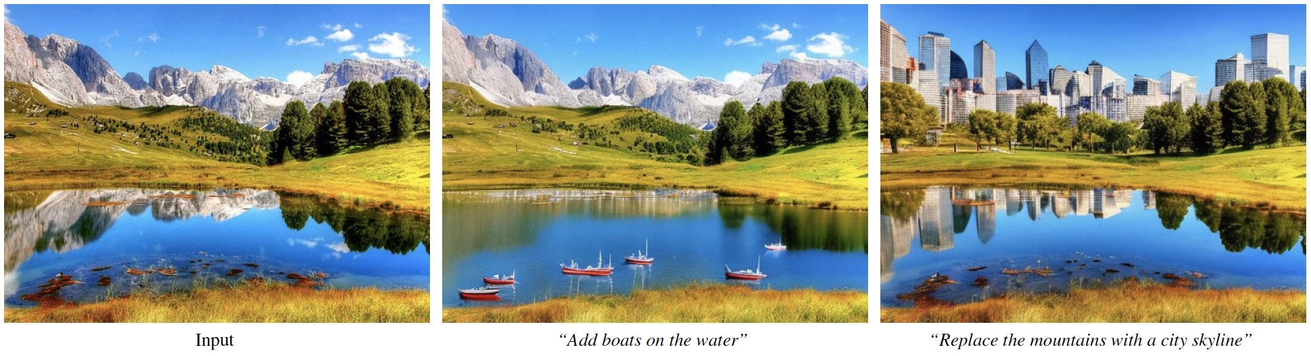
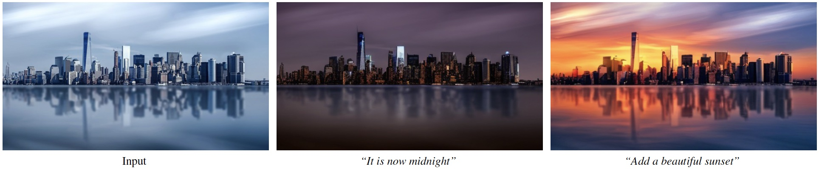

Slide 18
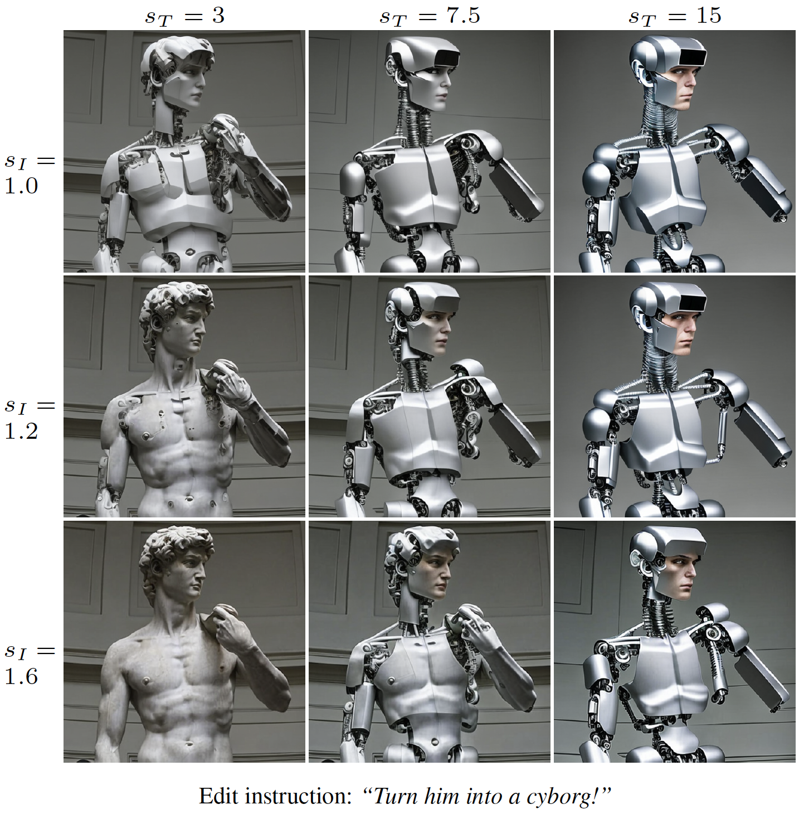
Classifier-free guidance (CFG) for two conditionings
“Turn him into a cyborg!”
CFG extrapolates samples toward stronger conditioning:

Slide 19
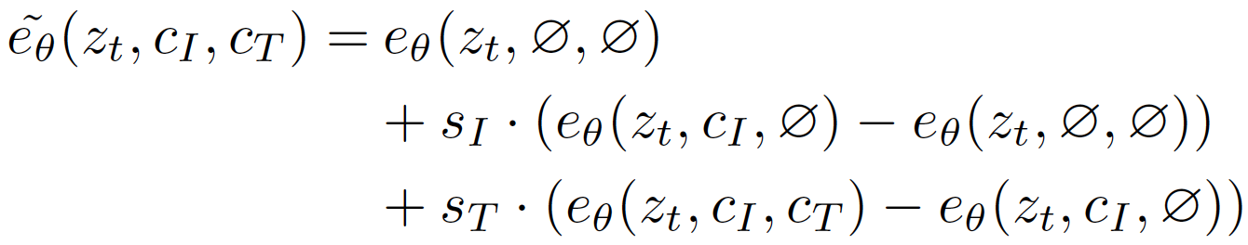
Classifier-free guidance (CFG) for two conditionings
“Turn him into a cyborg!”
CFG extrapolates samples toward stronger conditioning:
We apply CFG with separate scales for image and text conditionings:

Slide 20
Classifier-free guidance (CFG) for two conditionings
“Turn him into a cyborg!”
CFG extrapolates samples toward stronger conditioning:
We apply CFG with separate scales for image and text conditionings:

Slide 21
Data scale and quality is crucial
How well does output image match input image?
How well does change in images match change in captions?
Evaluate for a range of guidance scales. Text: 7.5, Image: 1.0-2.2

Slide 22
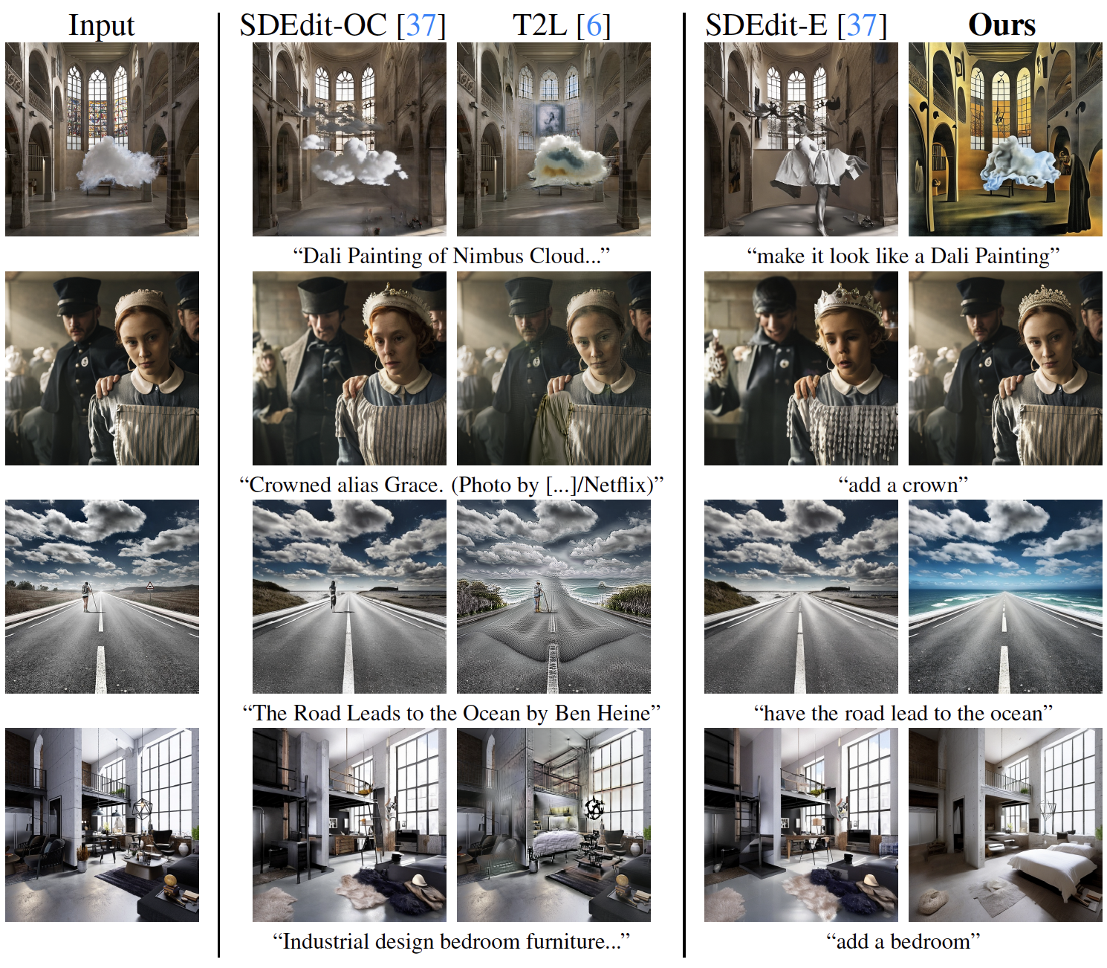
Baseline comparisons
Input
SDEdit (caption)
Text2Live (caption)
SDEdit (instruction)
Ours

Slide 23
Baseline comparisons
Input
SDEdit (caption)
Text2Live (caption)
SDEdit (instruction)
Ours

Slide 24
Baseline comparisons
How well does output image match input image?
How well does change in images match change in captions?
Our model achieves a superior tradeoff.

Slide 25
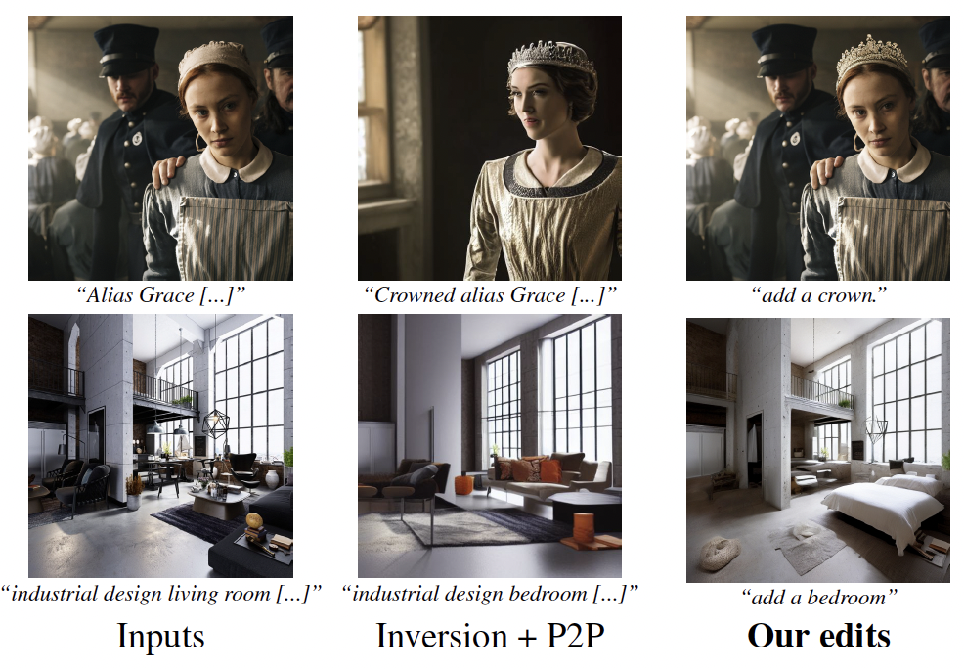
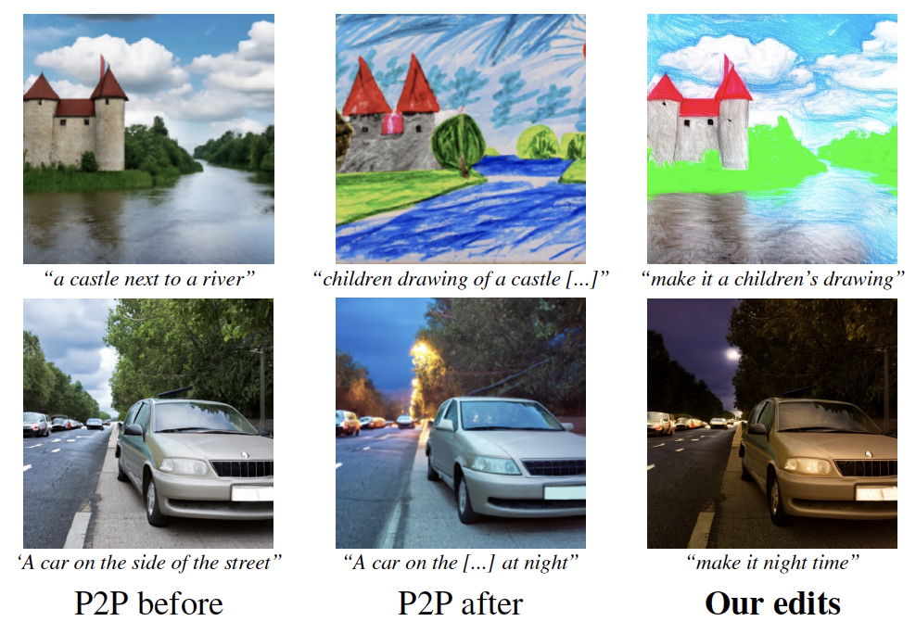
Prompt2Prompt comparisons
Editing real images
Editing generated images

Slide 26
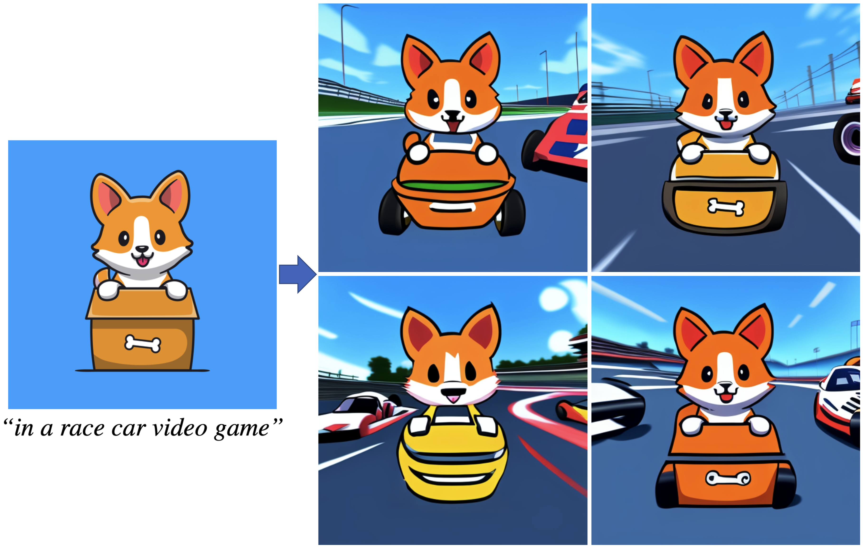
Varying latent noise produces diverse samples

Slide 27
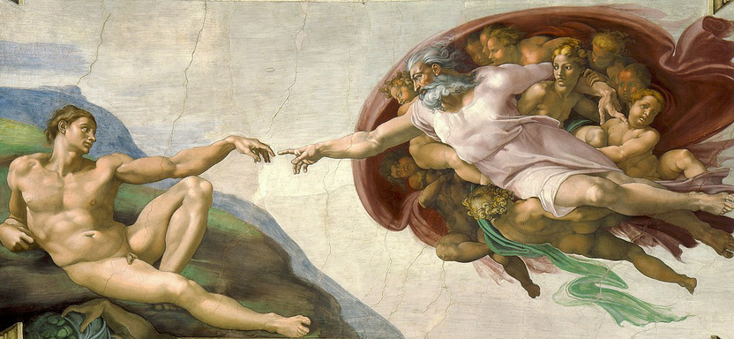
Our model generalizes to high resolutions

Slide 28
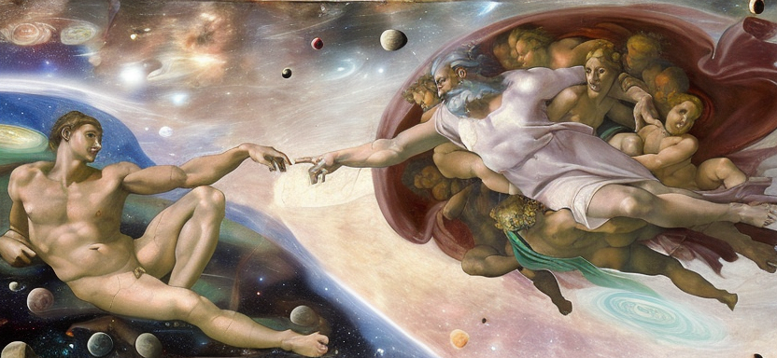
Our model generalizes to high resolutions
“Put them in outer space”

Slide 29
Our model generalizes to high resolutions

Slide 30
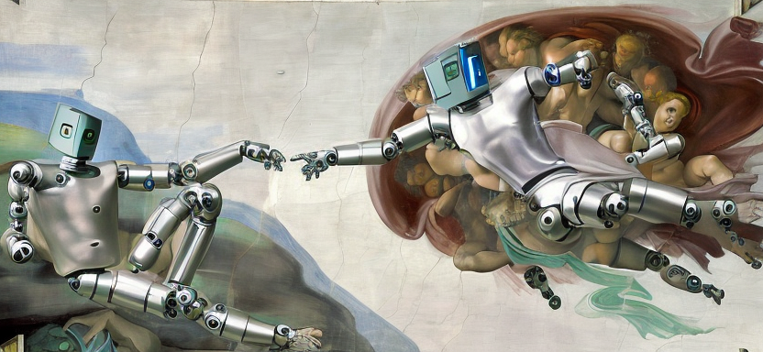
Our model generalizes to high resolutions
“Turn the humans into robots”

Slide 31
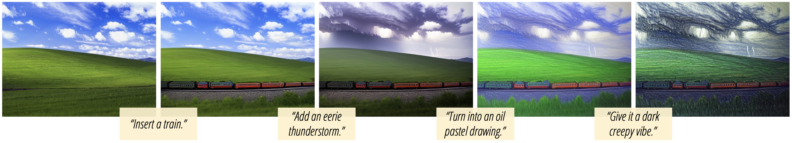
Fast models enable iterative editing
Can easily apply edits in a sequence.
Benefit of our model being feed-forward (no inversion/finetuning).
Inference takes < 10s per edit of a 512x512 image.

Slide 32
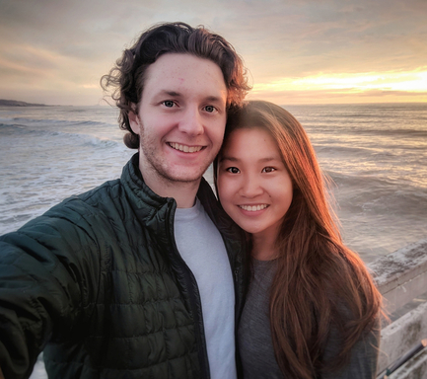
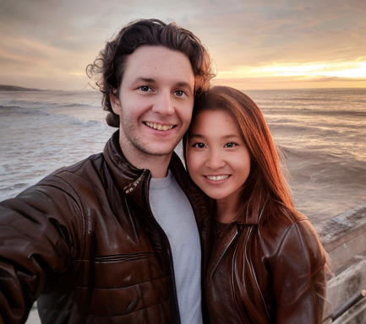
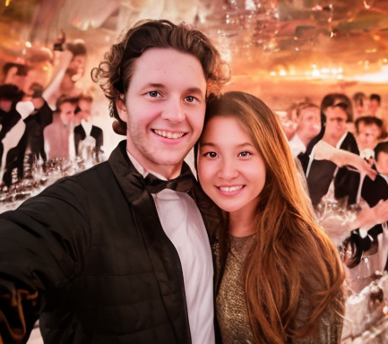
Human identity preservation
Reasonably capable at preserving identity.
Requires tuning CFG for specific images/edits.
Input
“Have them wear brown leather jackets”
“Replace the background with a fancy party”

Slide 33
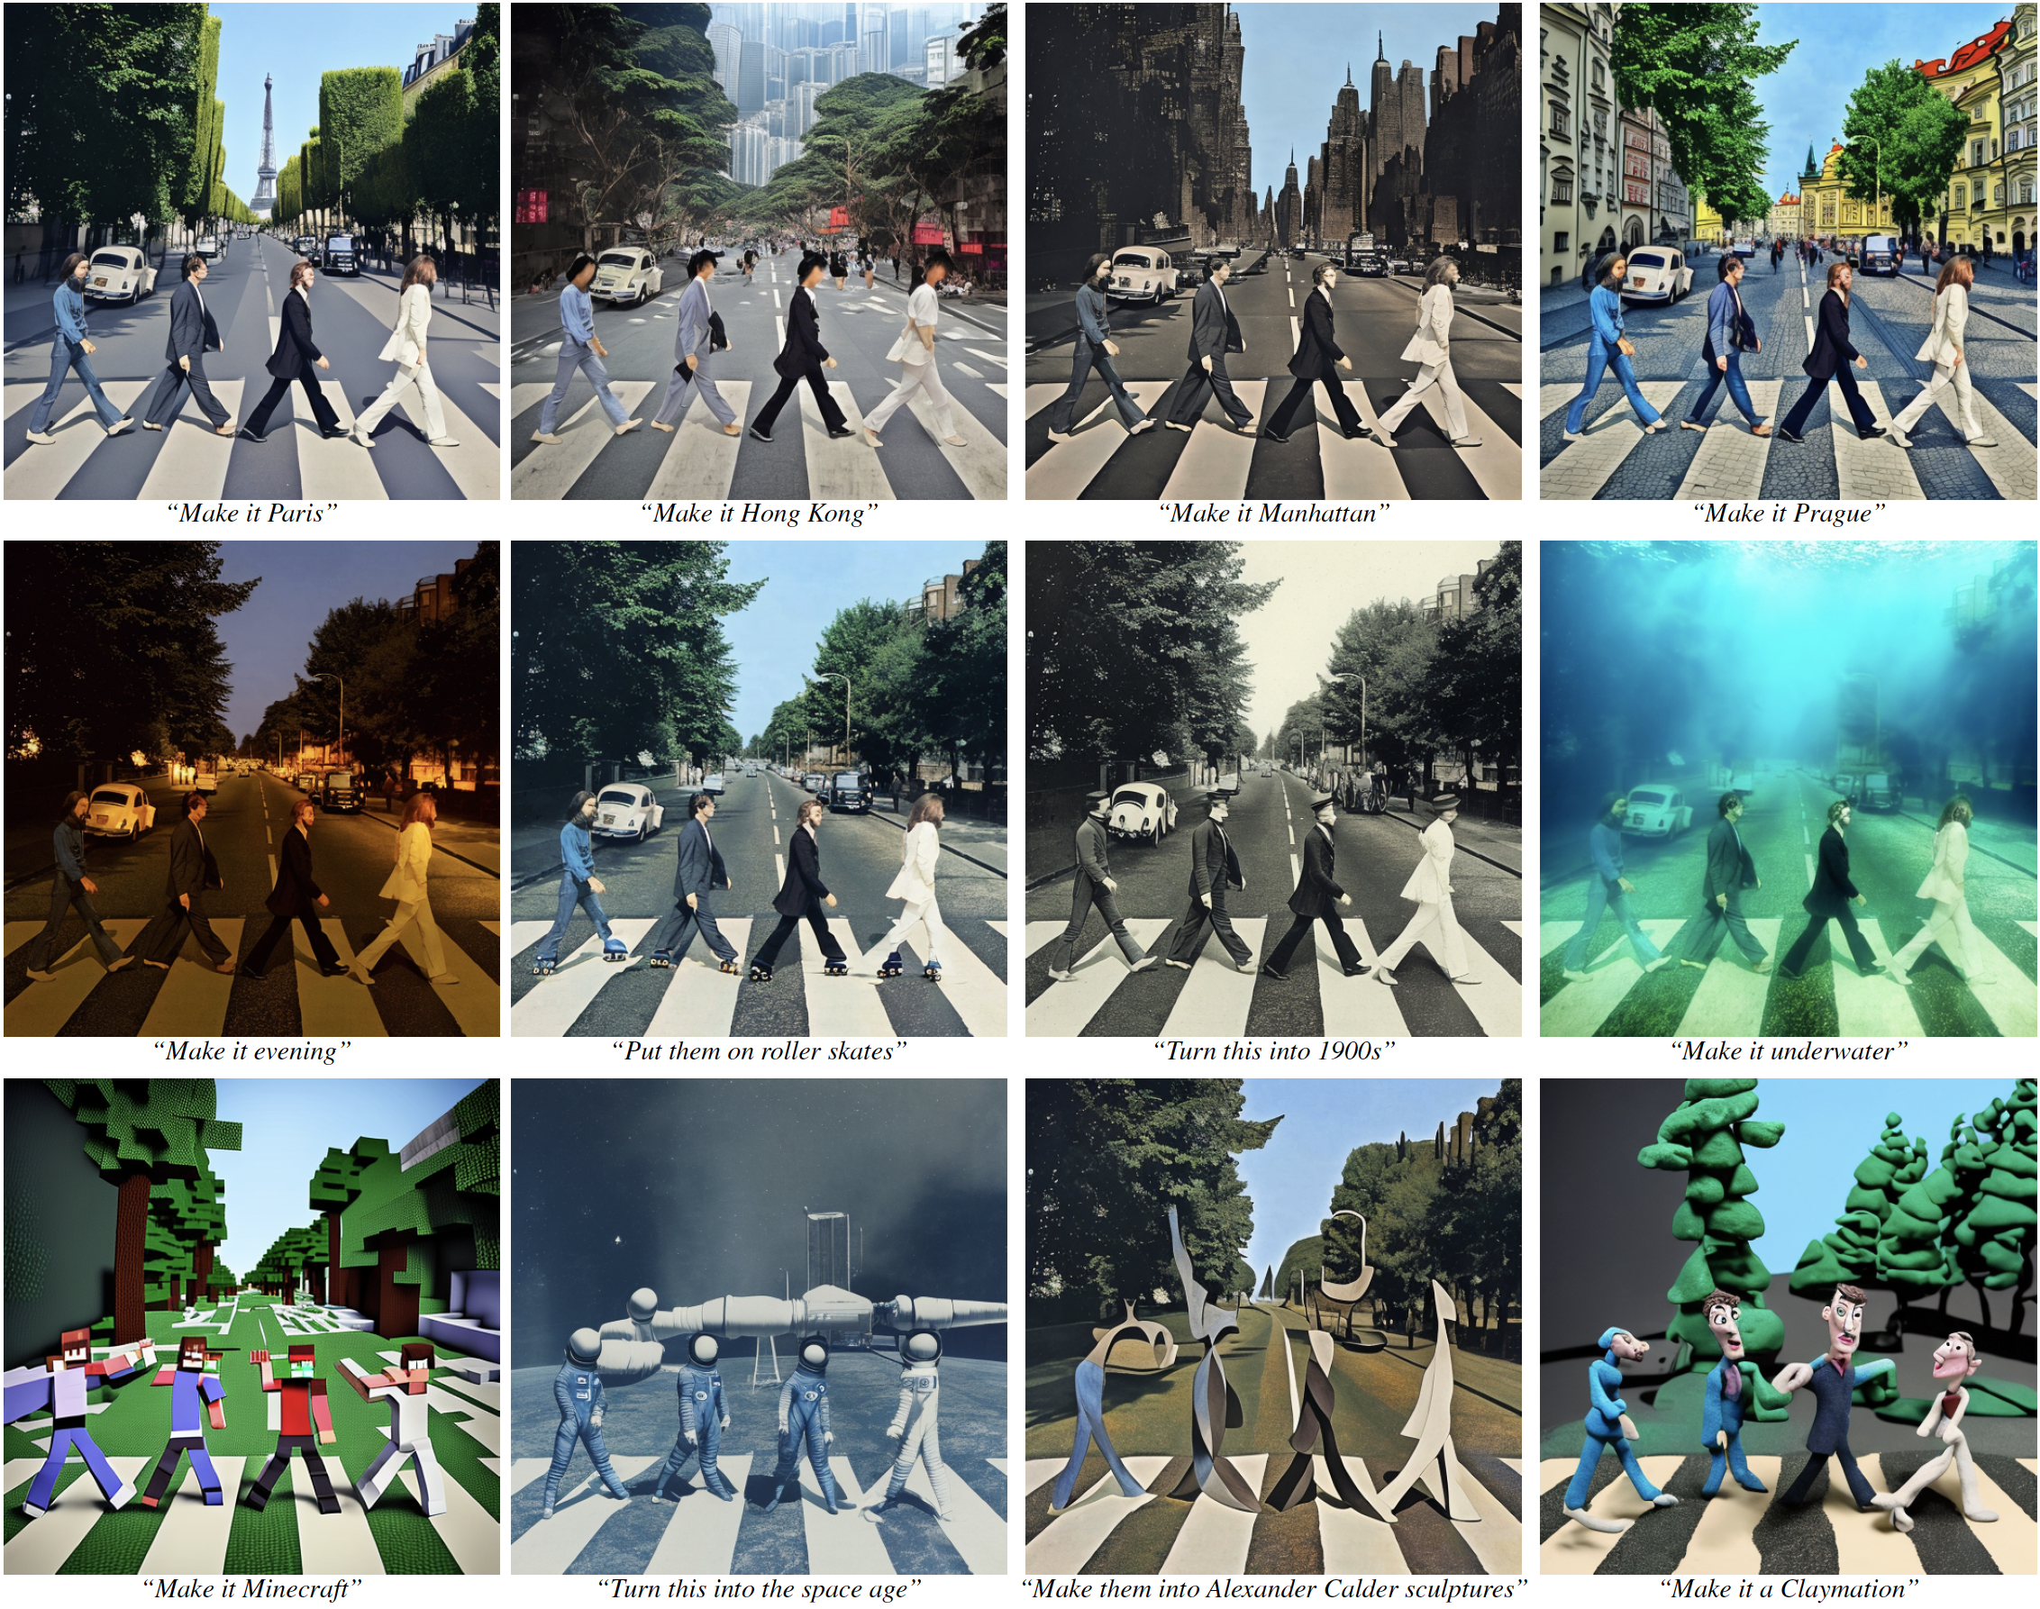

Slide 34
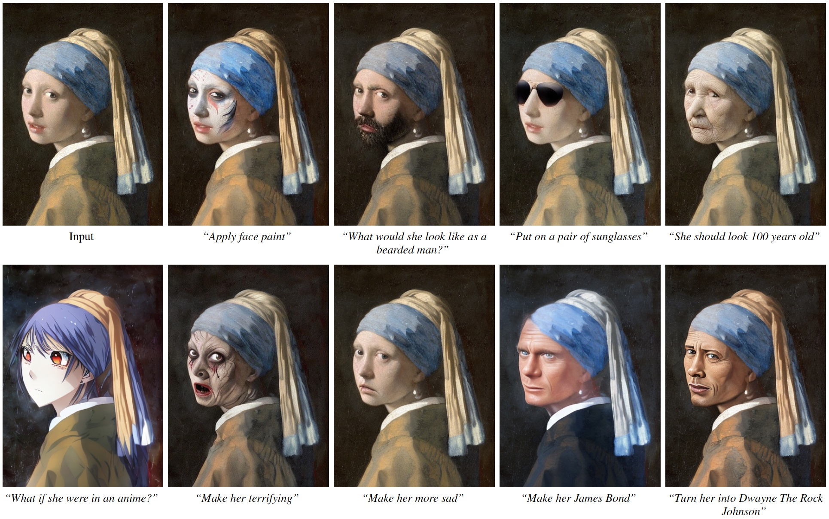

Slide 35
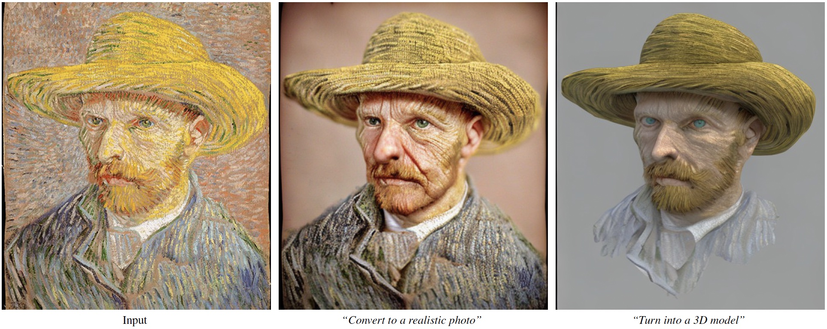

Slide 36
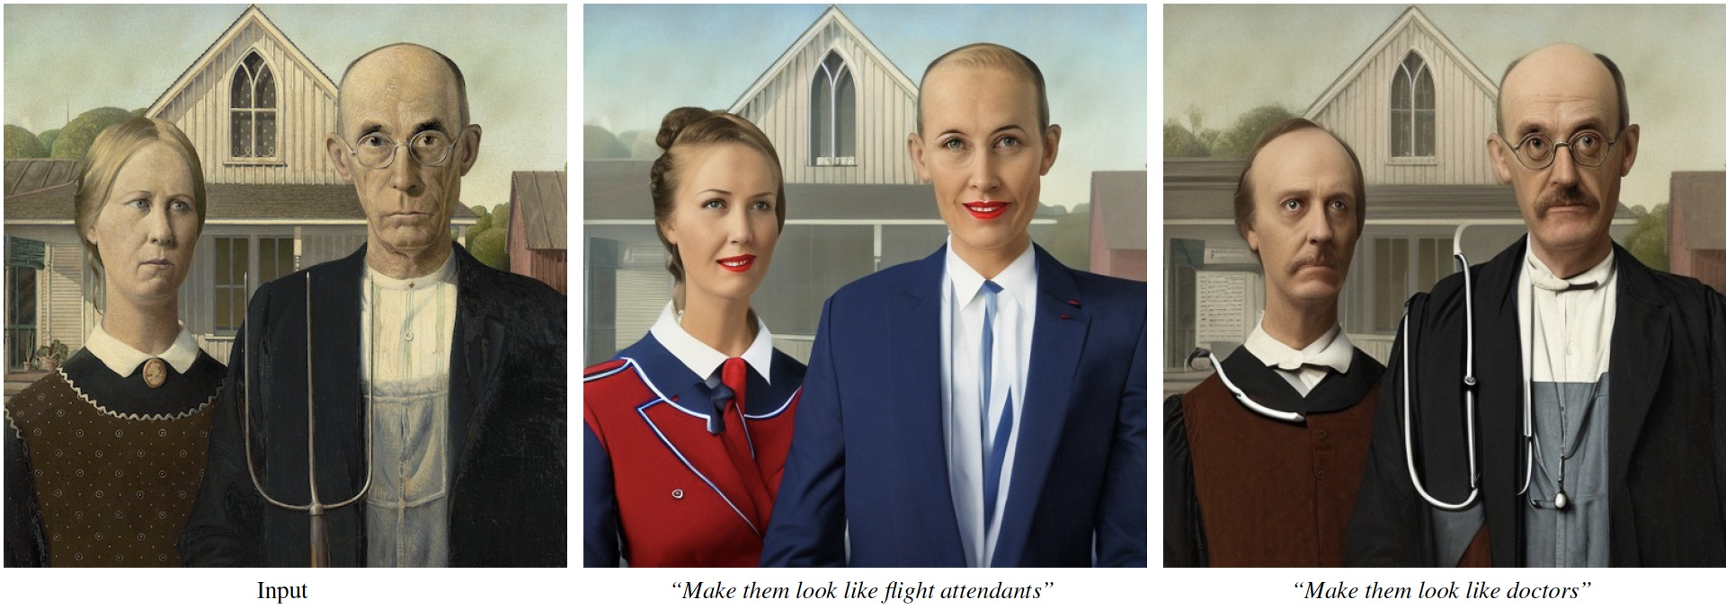
Bias in generated images
Our model learns biases such as correlations between profession and gender.

Slide 37
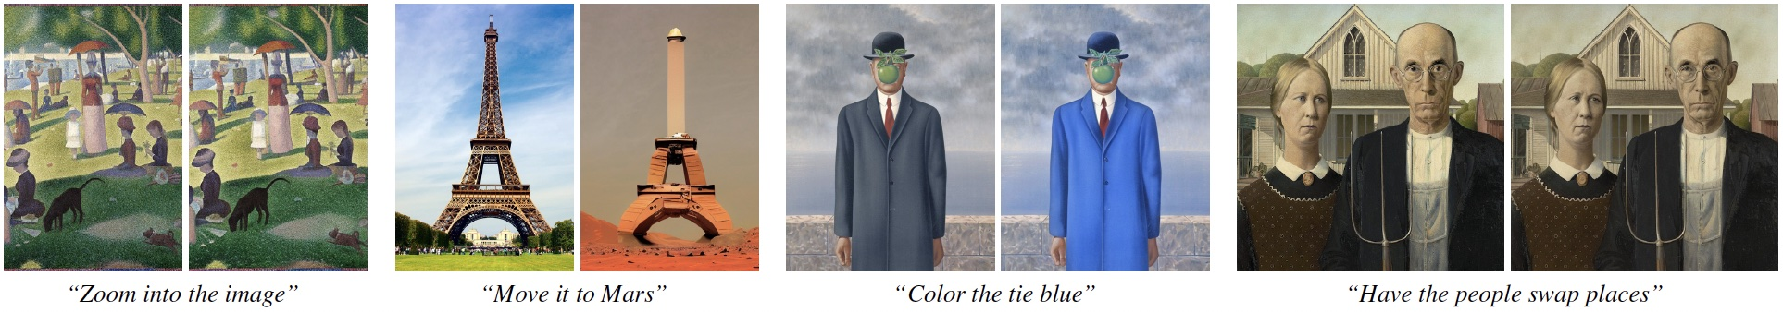
Failure cases
Unable to alter viewpoint or spatial layout.
Too significant of change (needs tuning CFG to prevent).
Difficulty isolating objects.

Slide 38
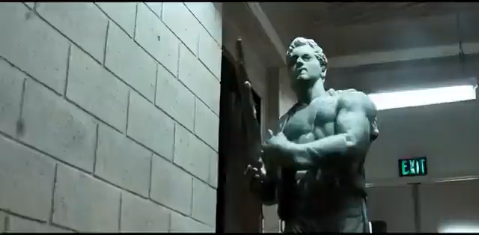
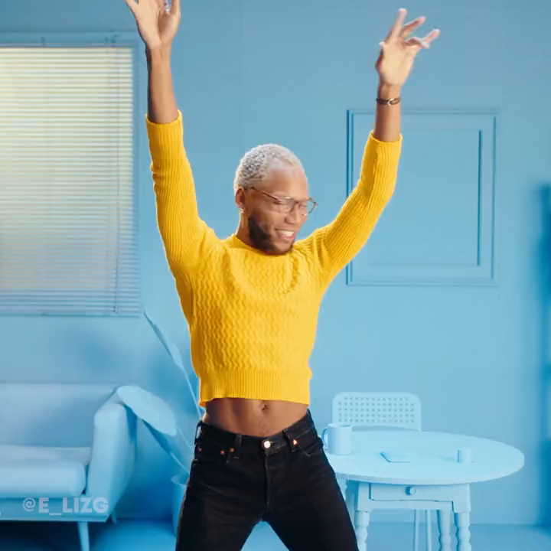
InstructPix2Pix for video editing
+EBSynth

Slide 39
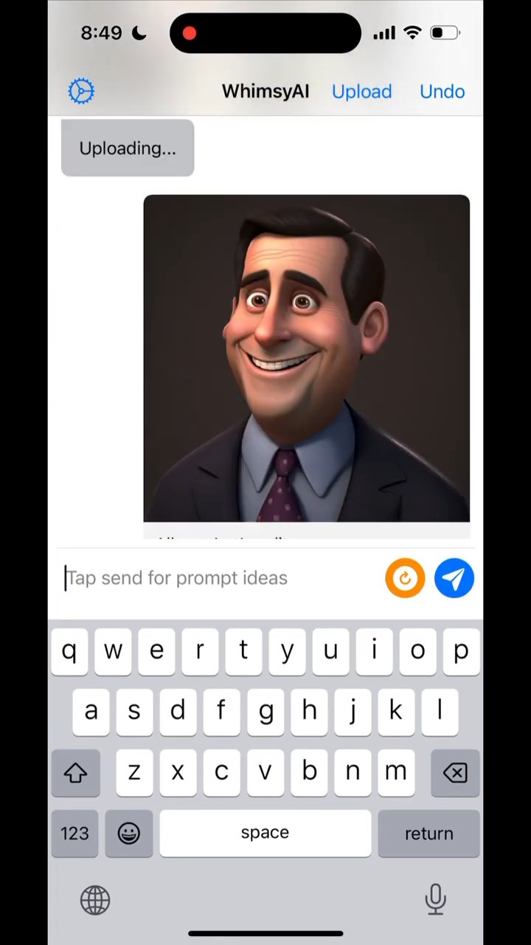
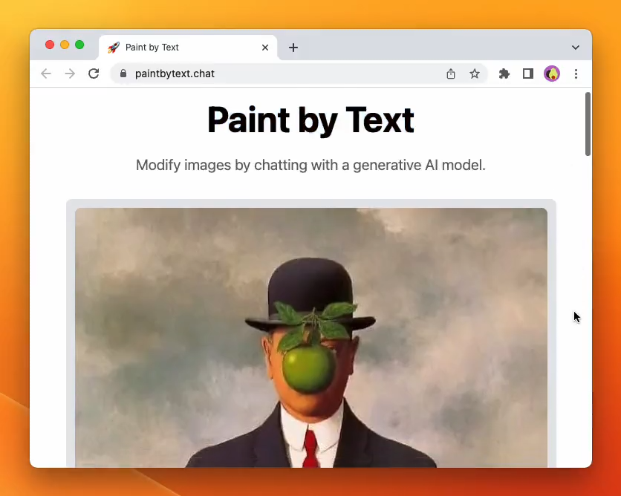
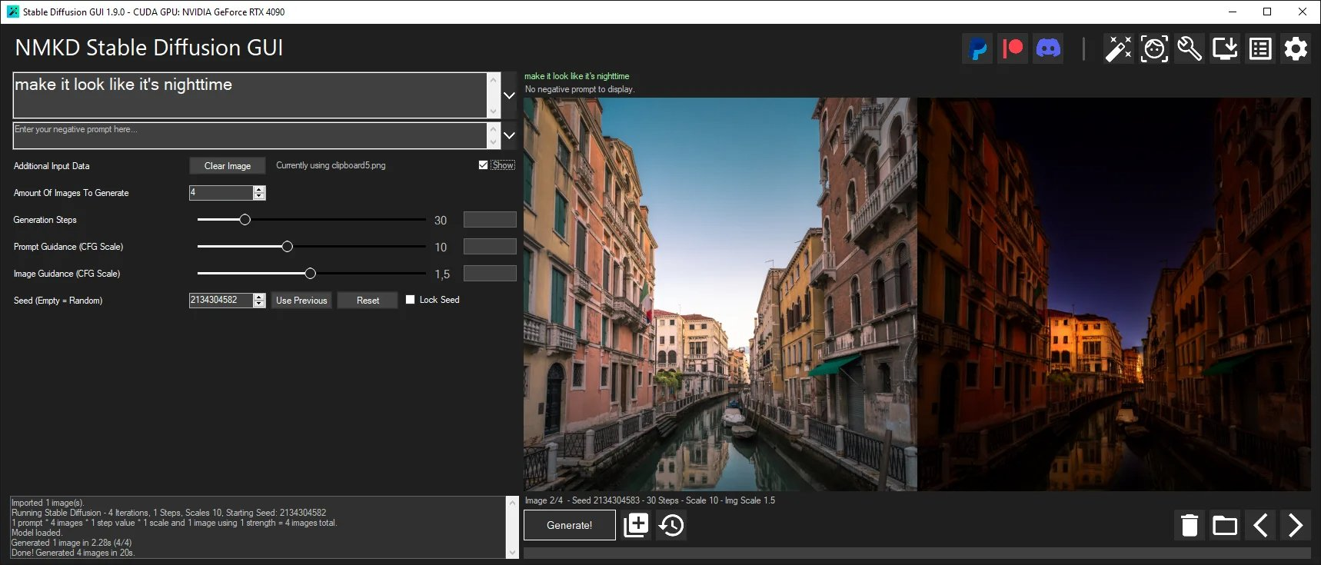
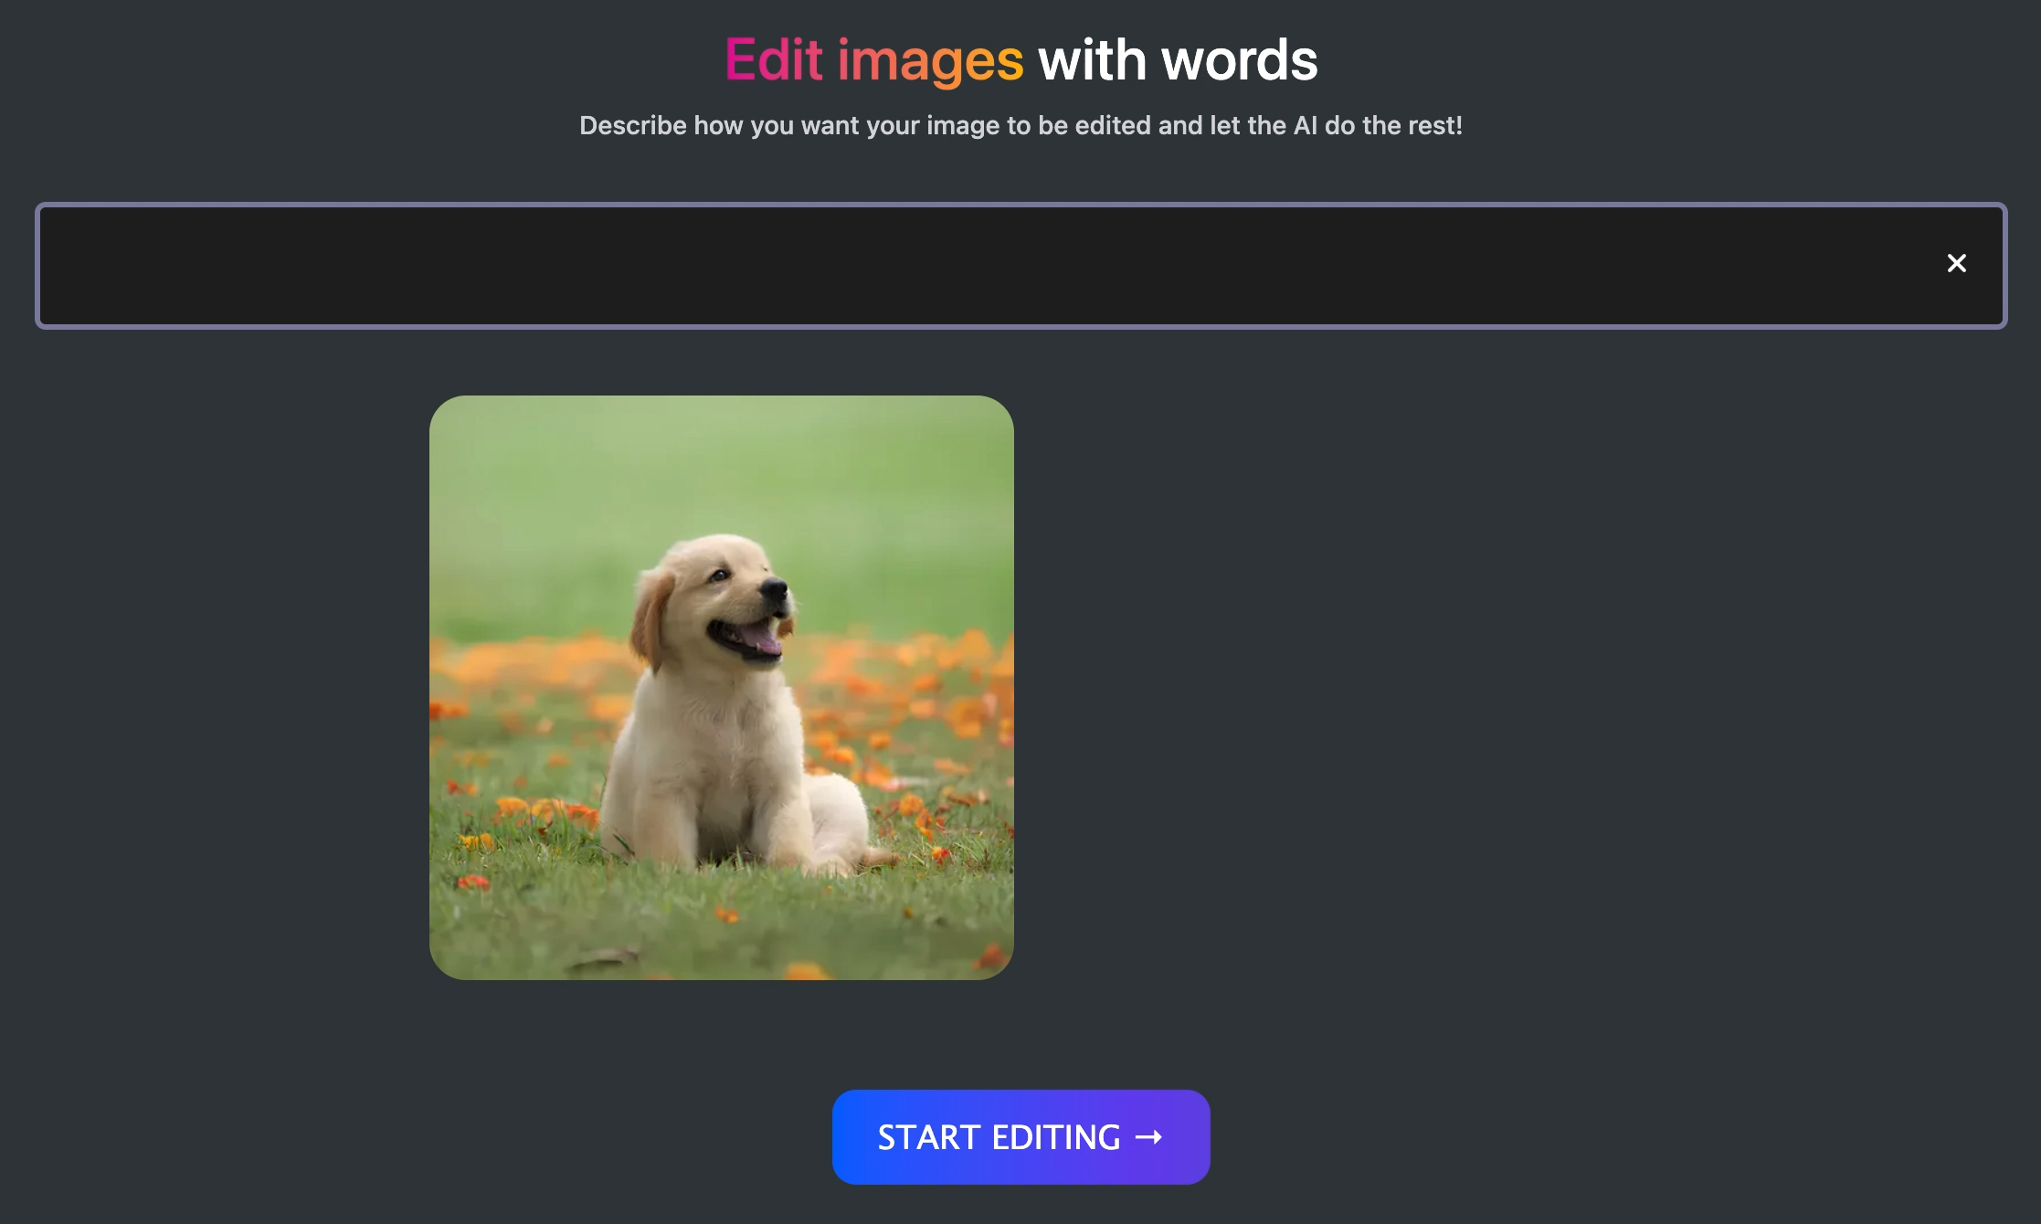
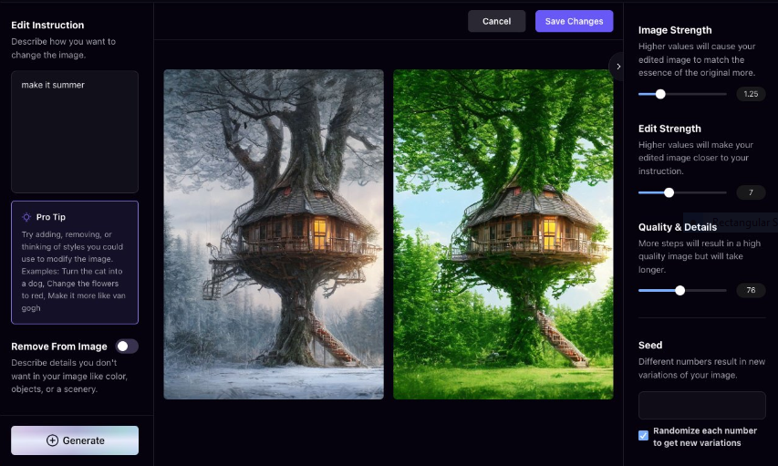

Slide 40
Thank you!

